Slide 1

Bank Loan Case Study
- A project by J . Athreya Sharma

Slide 2

Task 1: Identifying and using appropriate method to deal missing values
Tech-stack Used: Google-Colab because it has all in-built modules readily available and is versatile and is very popular nowadays.
Approach: So inn order to deal with the missing values firstly I uploaded the 2 datasets namely ‘Application_data’ & ’previous_data’ into the Colab using pandas and identified the missing values using isnull().sum() method .
Then I assigned a min value as 3000 because if a column has 3000 null values what use it would be so I dropped all those columns. Then I removed columns like flag_document_2,3…. Because the column description was not clear.
Then I once again checked for null values in the dataset and used methods like ffill,fillna with mean,mode,etc..
Also I have converted the negative value of certain columns to positive using abs() function.
Then I repeated same steps of cleaning for ’ Previous_data ‘ dataset too.

Slide 3

Continued…
Insights : Cleaning of dataset is a very crucial part of data analysis, and also data-analysts spend almost 70-80% of the time just to clean the data because the cleaner the data the better are the insights derived form it.
Result: The result of this cleaning the data is shown in the drive link pasted in the last second slide of this ppt and until row no 167 I have performed the data cleaning and also explained the analysis in depth .
In the next slide I have attached snippets of cleaned datasets of both ‘Application_data’ & ’Previous_data’ .

Slide 4
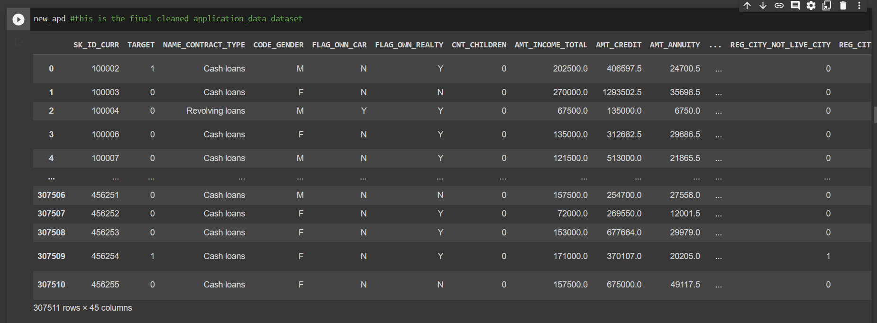

Slide 5
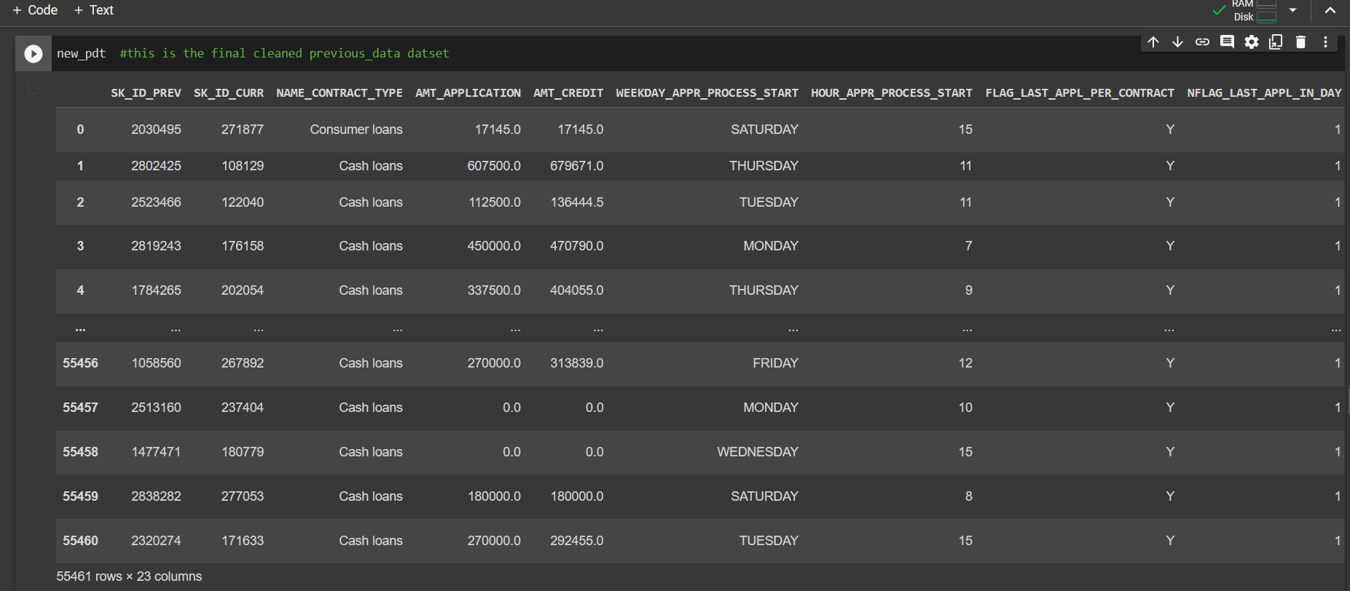

Slide 6

Task 2: Identifying outliers in the dataset
Tech-stack Used: Google-Colab because it has all in-built modules readily available and is versatile and is very popular nowadays.
Approach: In order to find outliers in a dataset in python we have methods like: Interquartile-Range, Z-score method and also visualizing techniques like using boxplots, scatterplot .
The most common method to find outliers is Z-score method for those who have programming knowledge and while others can rely upon graphical methods like using of boxplots and scatter plots.
I used all the three methods using modules like seaborn , matplotlib and also some statistical methods like mean ,standard deviation to find z-score.
I calculate z-score using the formula (data-mean)/standard deviation.

Slide 7

Continued…
Then I printed those values whose z-score value was greater than the threshold value which in this case I took as 3.
Then I applied this function to all the columns which are numeric in type.
To create a box plot to identify numerical columns I used the seaborn library and apart from this I also tried to find outliers in the columns like ‘CNT_CHILDREN’ and the largest outlier was 19.
Also I created a scatter plot between ‘CNT_CHILDREN’, and ’NAME_EDUCATION_TYPE’ to find what kind of outliers we can find wrt these two columns and did the same for columns ‘AMT_INCOME_TOTAL’, ’NAME_EDUCATION_TYPE’ to find the outliers between the 2 columns I.e. how varied are the values for the columns.

Slide 8

Continued…
Apart from these I also calculated outliers for ‘CNT_CHILDREN’ column alone using a boxplot and the only outlier found was 1 as most people who applied to loan had an annual income of less than 1 lakh so only one person was there who had an annual income of more than 1 lakh and still applied for the loan
Then I calculated the outliers for the column DAYS_EMPLOYED using a box plot same as above and found the outliers using the module matplotlib.
There are very less outliers because we have removed all unnecessary columns and also filled the null values with suitable values so there are negligible outliers in all the cases we have seen until now.
The graphs of these 2 cases Is attached in the below slides.

Slide 9
Continued…
Insights: Outliers need to be identified for a dataset because they are a part of useful information in the data. These not only help in identifying errors and inconsistencies but also has a great impact on statistical results .
Removing outliers from the data gives a clean data which gives beautiful insights when analyzed and visualized.
Not all outliers are bad some are useful in fact for their uniqueness like id column but some outliers which occur due to poor sampling , measurement errors must be removed.
Results: The box plot for all the numerical combined columns , count of children column outliers, outliers of count of children , scatter plots for name of education type , amount income total and name of education type ,and outliers presented in the form of box plot for only the column of amt_income_total , days_employed, cnt_children individual columns outliers snippets also are attached in the next slides.

Slide 10
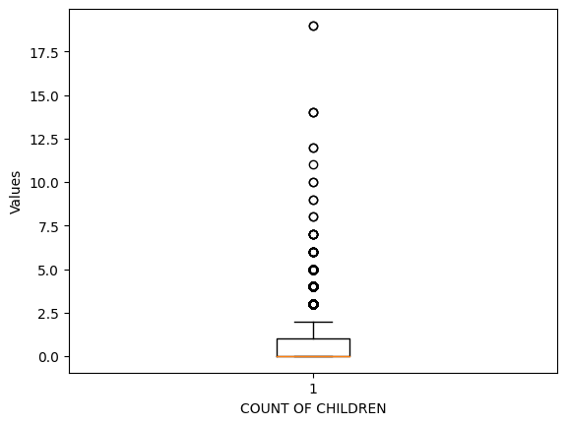
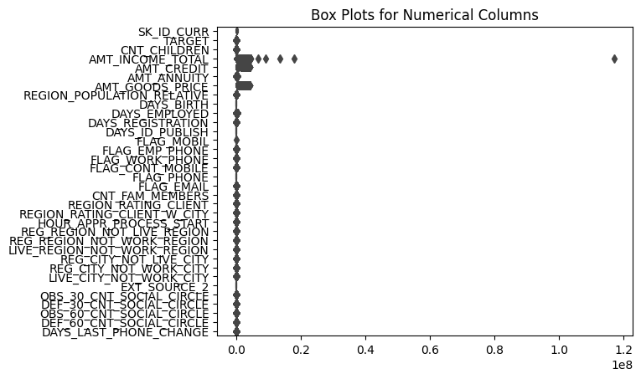

Slide 11
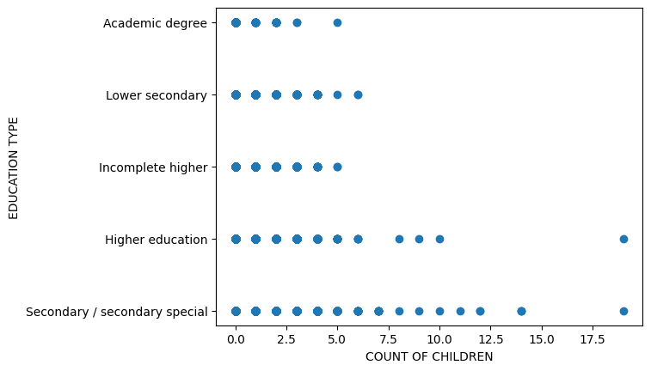
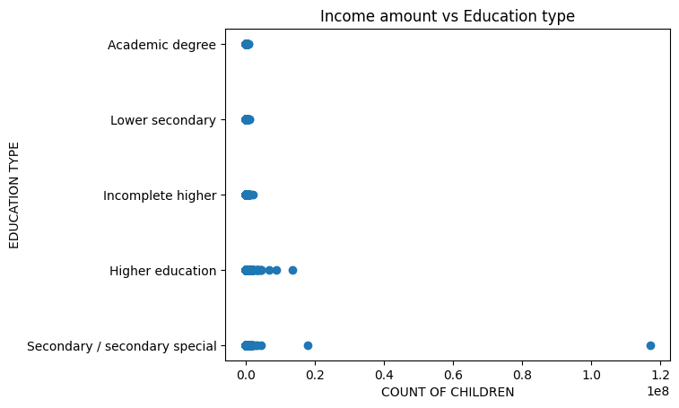

Slide 12
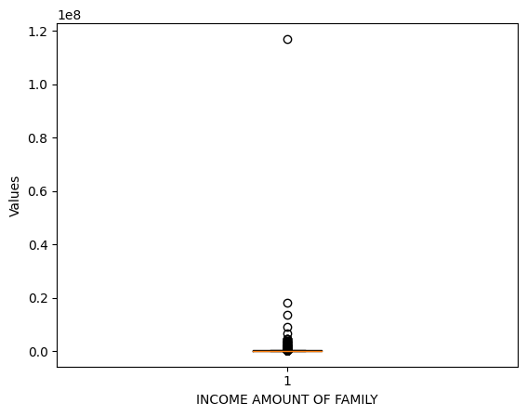
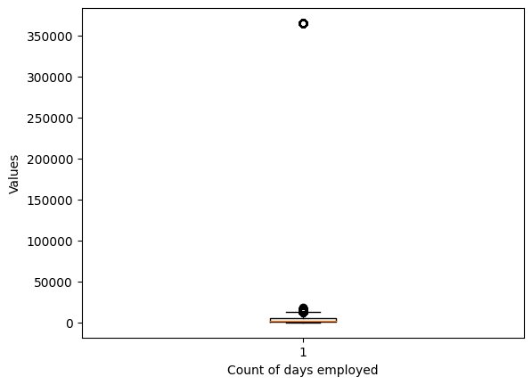

Slide 14

Task 3: Finding Imbalance in The data
Tech-stack Used: Google-Colab because it has all in-built modules readily available and is versatile and is very popular nowadays.
Approach: So data imbalance generally occurs when the distribution of the target variable (clients with payment difficulties) is heavily skewed towards only one particular value .
If the imbalance ratio is greater than 1 , it indicates data imbalance that . So in order to approach this problem I used the value_counts() method to find the count of each variable in target column and then divided the count of 1’s by count of 0’s and found the imbalance ratio.
In the similar way I calculated imbalance ratio for columns like ‘FLAG_WORK_PHONE’, ’FLAG_EMP_PHONE’, ’FLAG_EMAIL’, ’OBS_30_CNT_SCOIAL_CIRCLE’.

Slide 15
Continued…
In order to implement visualization of the data imbalance I used a pie chart to find the percentage of ‘TARGET’ column by dividing it to 2 scenarios namely: Payment difficulties and other cases.
Insights: Data imbalance definition is known but what I learned from this is that sometime data imbalance is also good . For ex: take the column ‘FLAG_EMP_PHONE’, here the data imbalance is greater than 1 so .
When I tried counting the values of no. of 1’s and 0’s I found out that the data imbalance ratio hugely differs but the difference should be high because the column description says that this column contains verified phone numbers of loan takers so of course the number of 1’s(yes) should be more because then only the process of loan sanction would be fair.
Result: The result of the imbalance data ratio with visualization of the imbalance data is attached in the next slides.

Slide 16
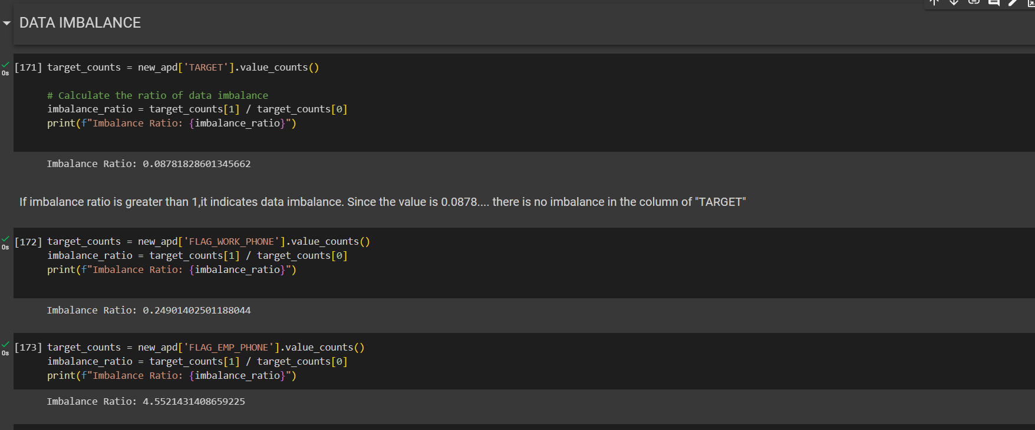

Slide 17
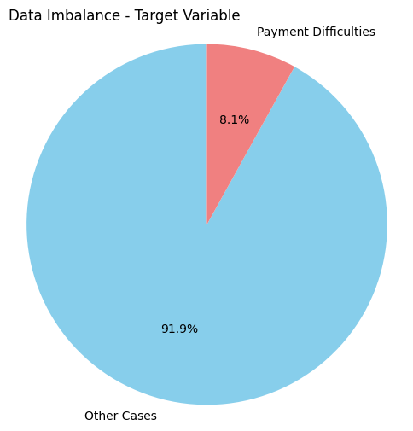

Slide 18

Task 4: Finding Results of Univariate, segmented univariate , Bivariate Analysis
Tech-stack Used: Google-Colab because it has all in-built modules readily available and is versatile and is very popular nowadays.
Approach: In order to perform all the above analysis we need to find out the distribution, central tendency, spread . This can be viewed using summary statistics and data visualizations such as histograms , box plots , density plots etc.
To understand univariate analysis I have created a histogram for the column ‘AMT_INCOME_TOTAL’ with a bins value of 30 .
Also I made a histogram for the column ‘WEEKDAY_APPR_PROCESS_START’ which indicates no.of people who applied on a particular weekday.
Similarly I made a histogram for univariate analysis of TARGET column for its count of number of 0’s and 1’s.
For univariate analysis I also took 2 separate columns for target 0 and target 1 and described these columns.

Slide 19

Continued…
For segmented univariate analysis I analyzed variables separately for different segments based on the target variable. This will help us understand how the distribution of each variable differs between clients with payment difficulties and other cases. I created a box plot for this segmented univariate analysis.
After this I also created a boxplot to find segmented univariate analysis for CNT_CHILDREN and TARGET.
And also created a countplot for the columns ‘CODE_GENDER’ and ‘TARGET’ . After this also created a countplot for finding segmented univariate analysis for ‘NAME_FAMILY_STATUS’ and ‘TARGET’.
For bivariate analysis I created a box plot with 2 columns ‘Target’ , ‘AMT_INCOME_TOTAL’.
Also created a scatter plot to show the bivariate analysis between ‘AMT_INCOME_TOTAL’ and ‘AMT_CREDIT’ with he as target.
For bivariate analysis I created a box plot with 2 columns ‘Target’ , ‘AMT_INCOME_TOTAL’.
And also for ‘AMT_INCOME_TOTAL’ and ‘AMT_CREDIT’.

Slide 20

Continued…
Insights: Univariate analysis provides insights into individual variables. For numerical variables, we use summary statistics like mean, median, standard deviation, etc. For categorical variables, we use frequency tables or bar plots to understand the distribution of each category.
Segmented univariate analysis involves analyzing variables separately for different segments based on the target variable. This helps us understand how the distribution of a variable differs between clients with payment difficulties and other cases.
Bivariate analysis examines the relationship between two variables. In this case, we are interested in exploring the relationship between predictor variables and the target variable ('Target’).
Result: The results of the above 3 kind of analysis in the form of histogram,box plot is attached in the next slide.

Slide 21

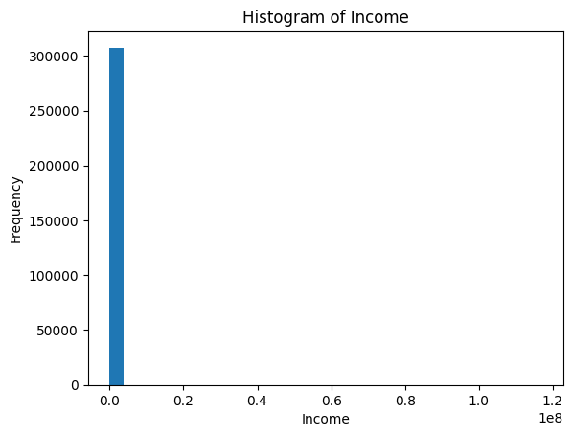
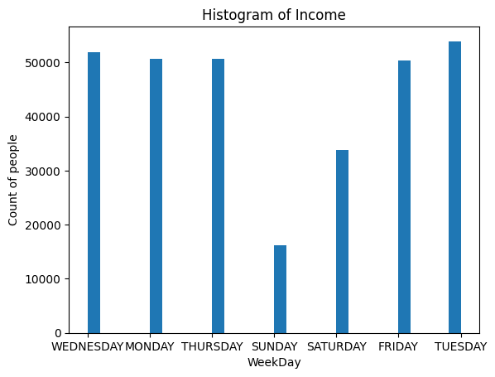

Slide 22
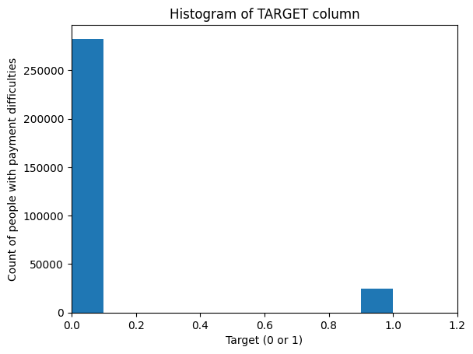

Slide 23
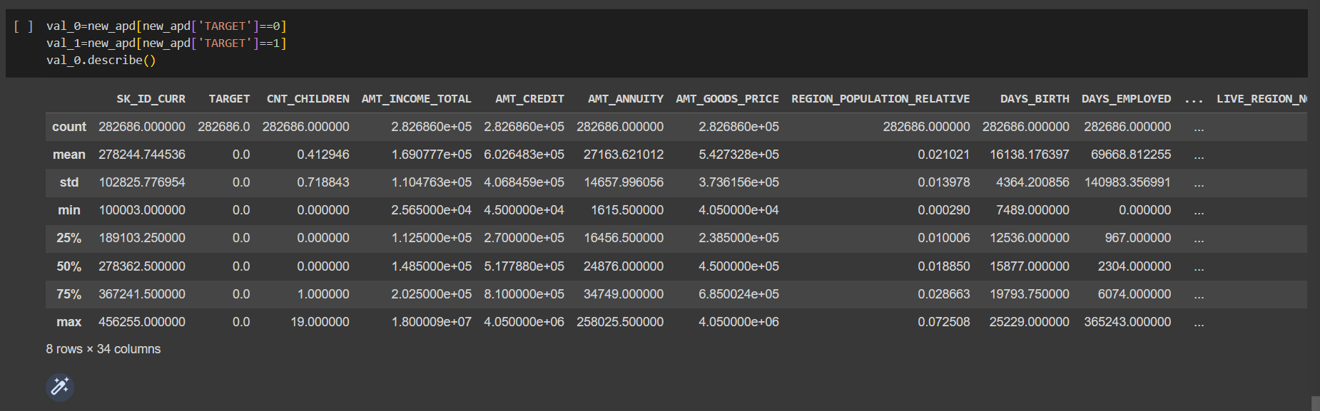
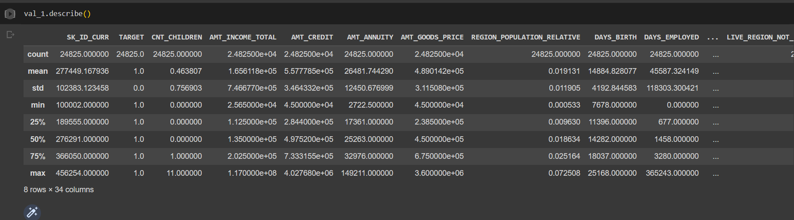

Slide 24
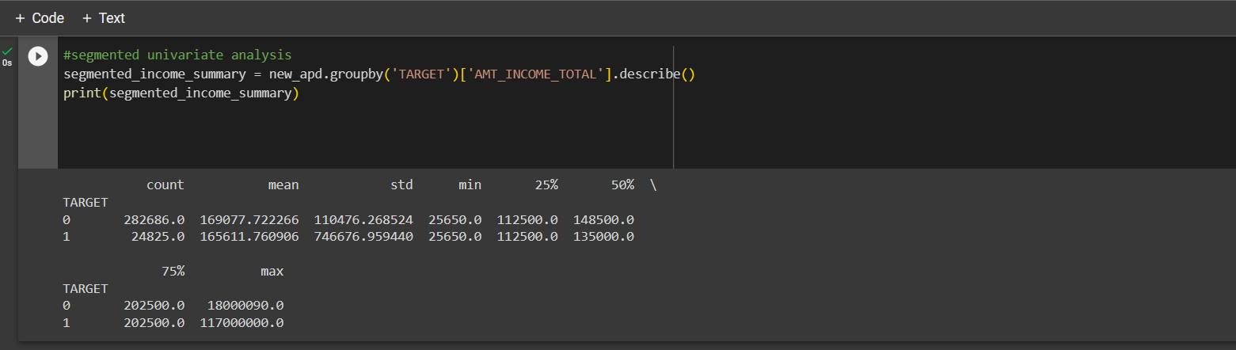

Slide 25
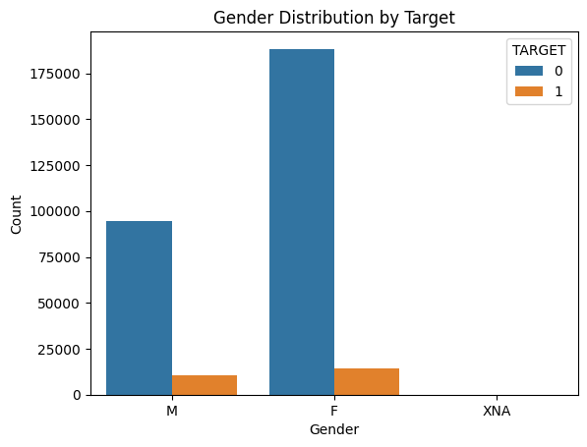
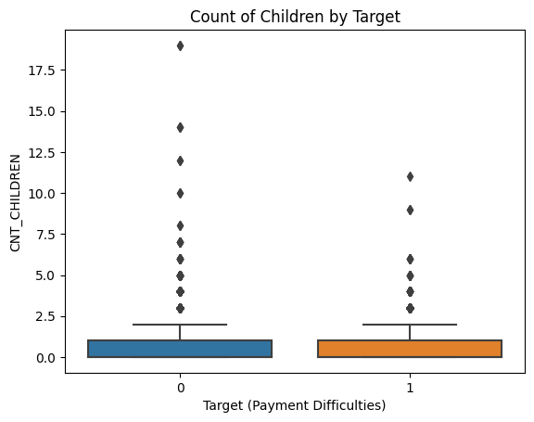

Slide 26
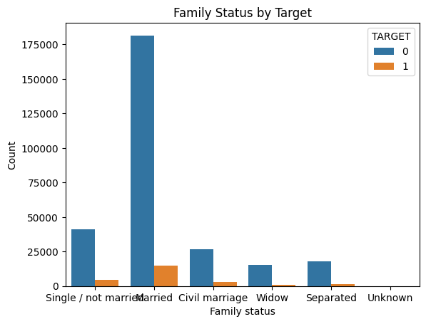

Slide 27
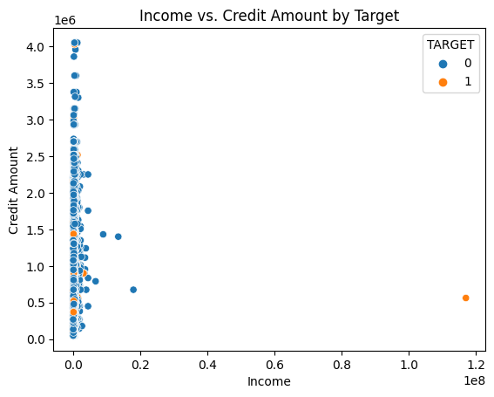
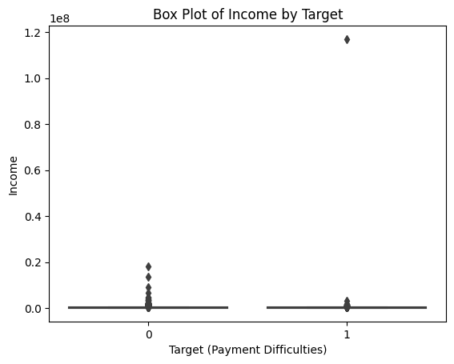

Slide 28

Task 5 : Top 10 Correlations for the Client with payment difficulties and all other cases
Tech-stack Used: Google- Colab because it has all in-built modules readily available and is versatile and is very popular nowadays.
Approach: In order to find the correlation between all numeric type columns excluding TARGET column first I created a variable to store only numeric column where I dropped the TARGET column.
Now I used corrwith() function to find correlation between TARGET column and columns except TARGET column and used nlargest(10) to find top 10 correlations.
Then used loc method to find the correlation values along with the column name.
After this I created a heatmap for the correlation values using seaborn library.

Slide 29
Continued…
Then I calculated the correlation for target column with values 0 and all other numerical columns except target column and created a heatmap and boxplot for the same
In this same manner I had calculated the correlation for target column with values as 1 with all other numerical columns except Target column and created a box plot, heatmap for the same.
Then I also calculated the correlation between ‘AMT_INCOME_TOTAL’ and ‘AMT_CREDIT’.
Then printed the value of correlation between these 2 columns .
And then plotted a graph between these columns using scatter plot in matplotlib library.

Slide 30

Continued…
Insights: Correlation is a statistical measure that quantifies the relationship between two variables. It indicates the strength and direction of the linear relationship between the variables. The correlation coefficient can take values between -1 and 1 .
A positive correlation means that as one variable increases other variable also tends to increase.
A negative correlation means that as one variable increases, the other variable tends to decrease.
If the correlation values Is 0 then it indicates that there is no relationship between the columns.
Result: The results of the top 10 correlations columns along with correlation heatmap is attached in the next slides.

Slide 31
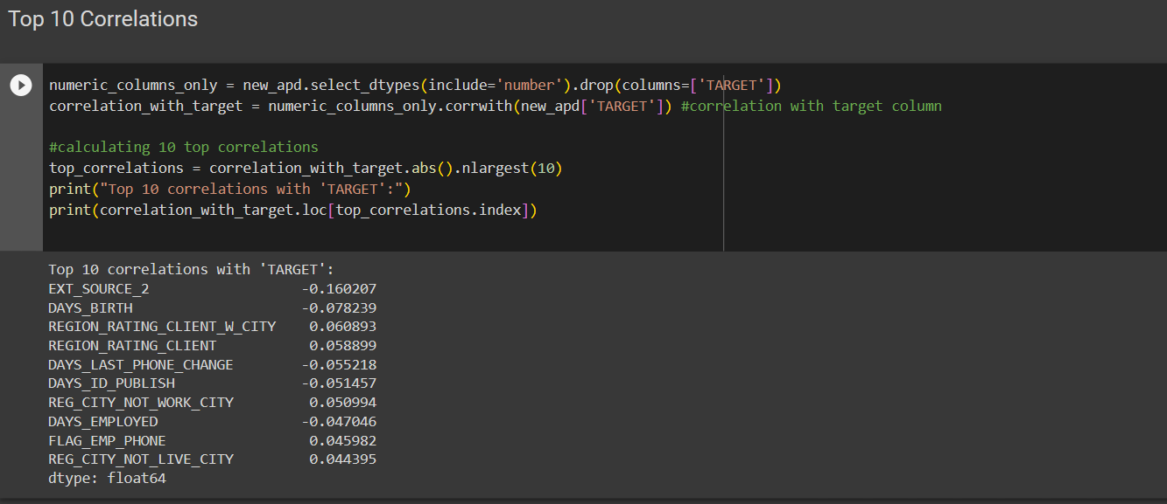

Slide 32
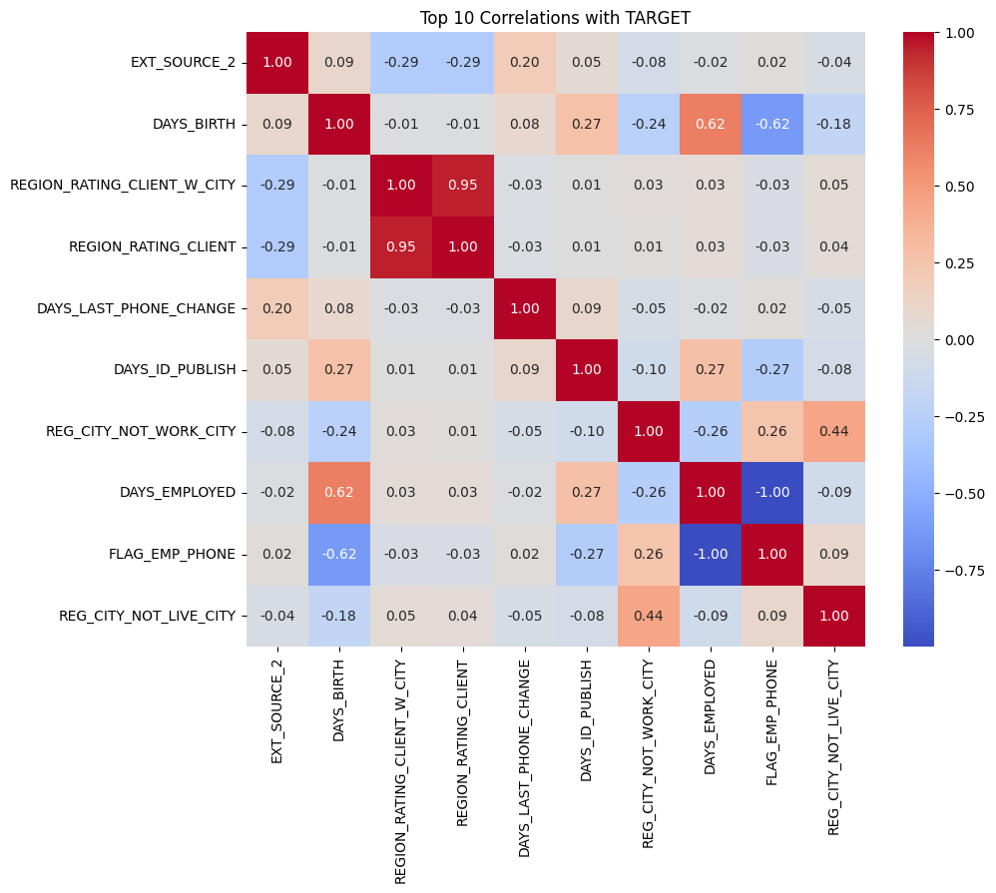

Slide 33
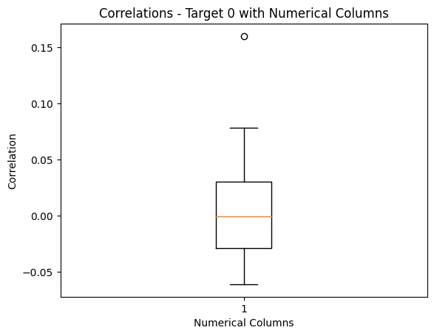
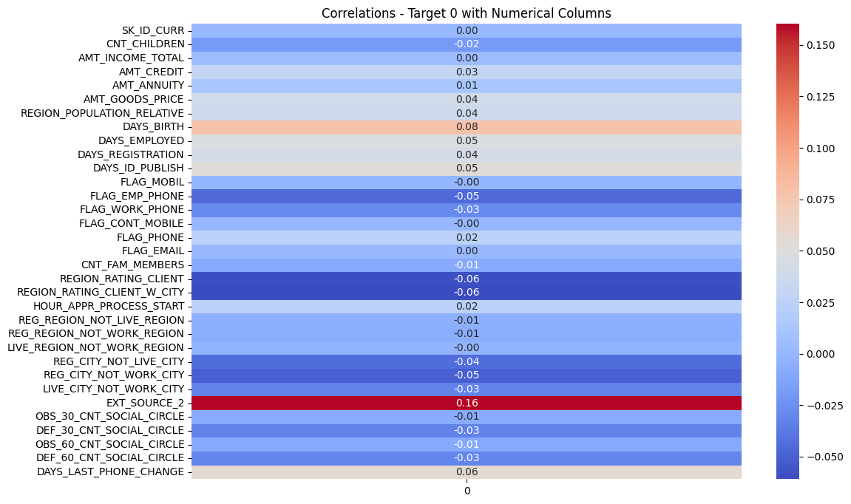

Slide 34
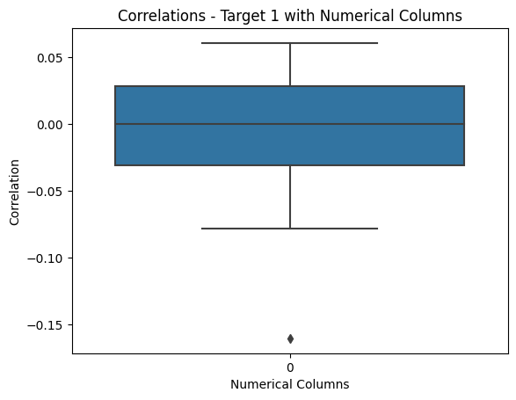
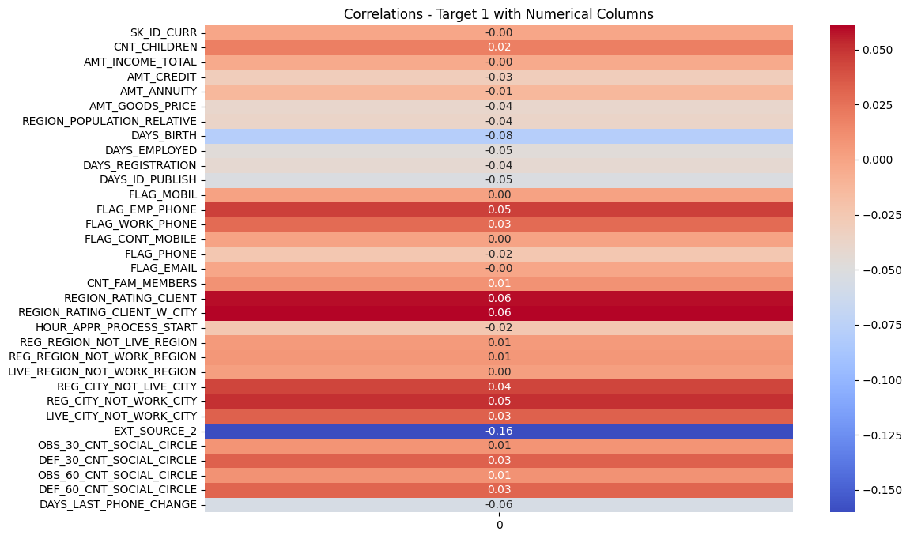

Slide 35
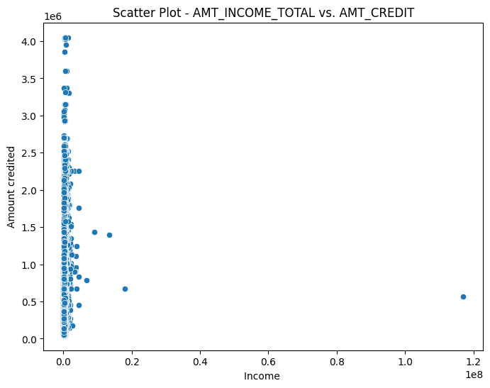
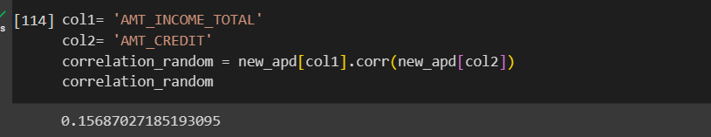

Slide 36
Overall Insight Summary:
The data is imbalanced, with a higher number of other cases than clients with payment difficulties.
Data imbalance for some columns can be greater than 1 and that is totally fine (ps: only some columns not all)
Outliers exist in some numerical columns, and they might need to be treated carefully during the analysis.
Segmented univariate analysis can help identify variables that differ significantly between clients with payment difficulties and other cases.
Top correlations with the 'TARGET' variable can provide valuable insights into important features for differentiation.

Slide 37
Drive Link of the Project : https://drive.google.com/file/d/1ak4o8WYtpgBzATKPXSu_3aV0LZrofh1C/view?usp=sharing

Slide 38

Thank you

